Slide 1
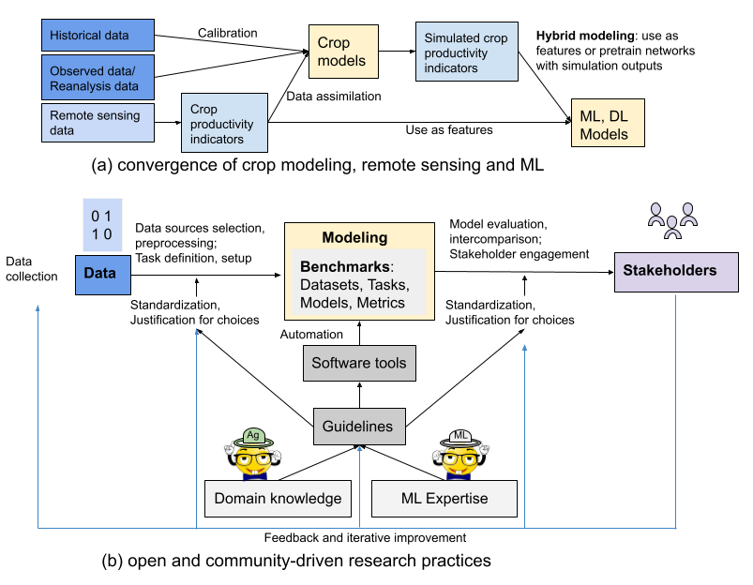




What is AgML

Slide 2
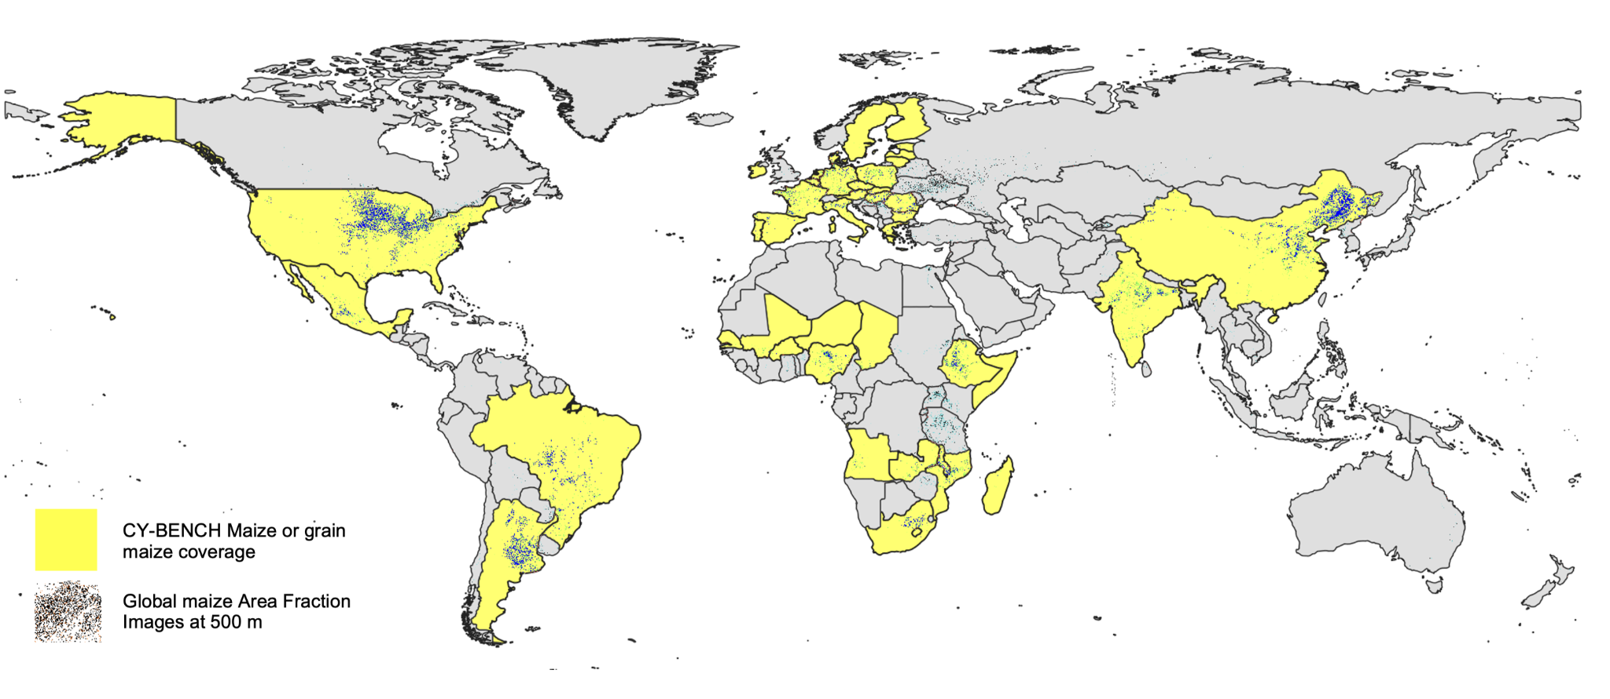
What is CY-Bench
2 crops, 38 countries for maize (shown above), 29 countries for wheat
Globally available inputs: weather, remote sensing, soil (moisture)

Slide 3
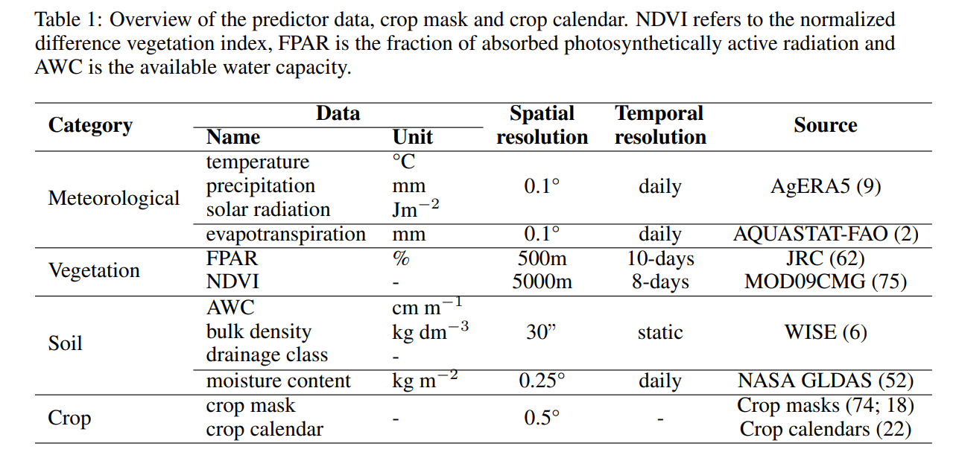
CY-Bench input data

Slide 4
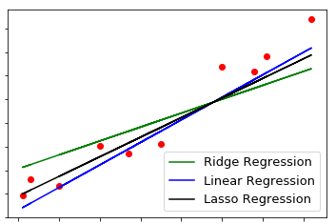
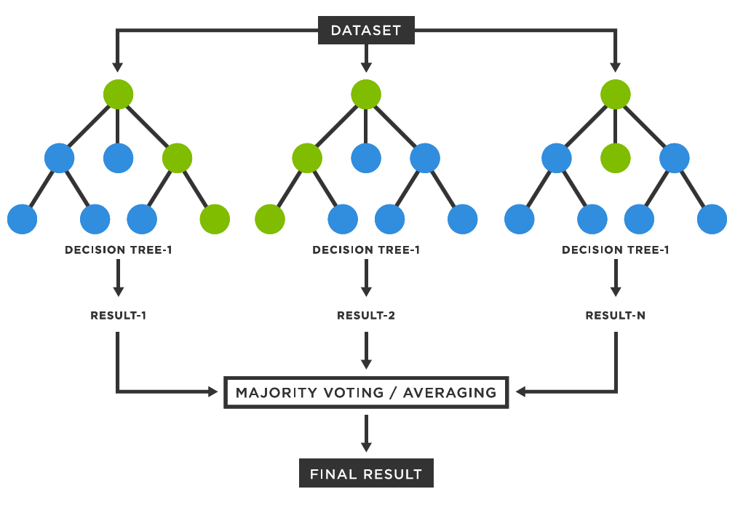

CY-Bench models
Linear Trend model
Average Yield model
Naive baselines
Sklearn Ridge
LSTM
InceptionTime (1-d CNN), Transformers
Sklearn Random Forest

Slide 5
CY-Bench evaluation
Source: https://upload.wikimedia.org/wikipedia/commons/c/c7/LOOCV.gif
Metrics:
Normalize RMSE
MAPE
r2

Slide 6
For interested participants
Clone repository in your laptop
Follow instructions in Getting started.
Run the benchmark.
Add your own model and run the benchmark.

